Slide 1
Dead-Simple Video Content Management
Let your filesystem do the work
Andreas Orphanides
NCSU Libraries
akorphan@ncsu.edu

Slide 2
The Skinny
The problem: Content management
Too many files in video webspace
Work repetition. Lots of it.
Diasporized video content/metadata
Cruft
The solution: Content management!
Basic content management principles
Segregate content from display logic
Arrange content into logical units
Minimal, streamlined scripting

Slide 3
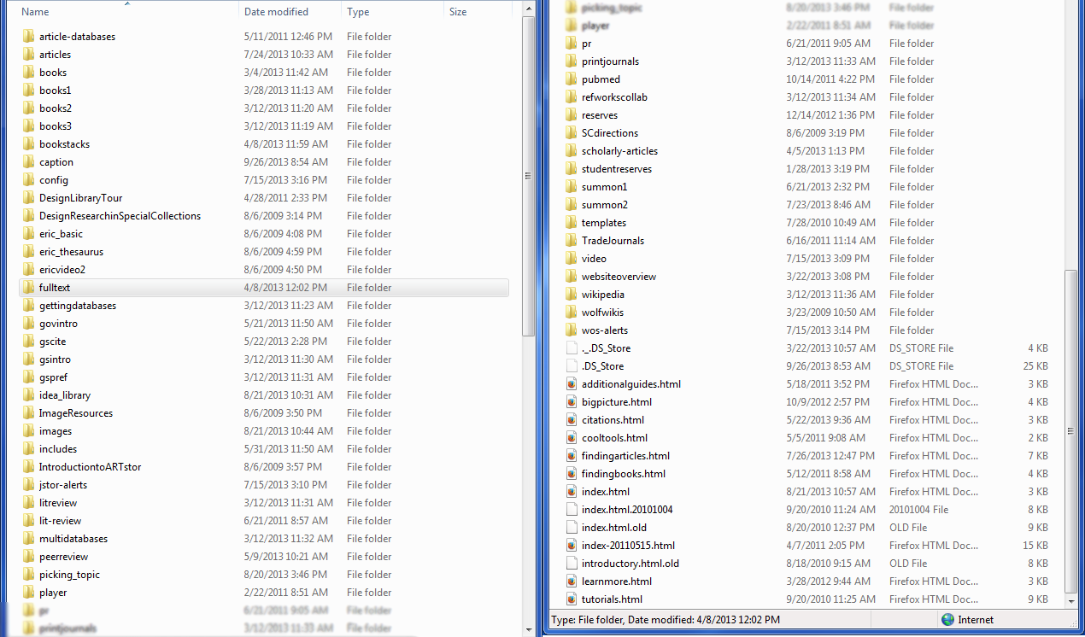
The Problem (part 1): Too many files!

Slide 4
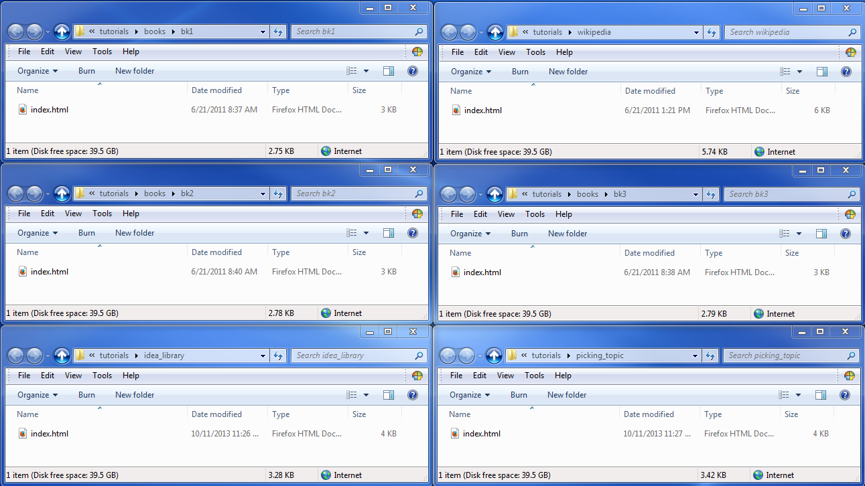
The Problem (part 2): Repetition

Slide 5
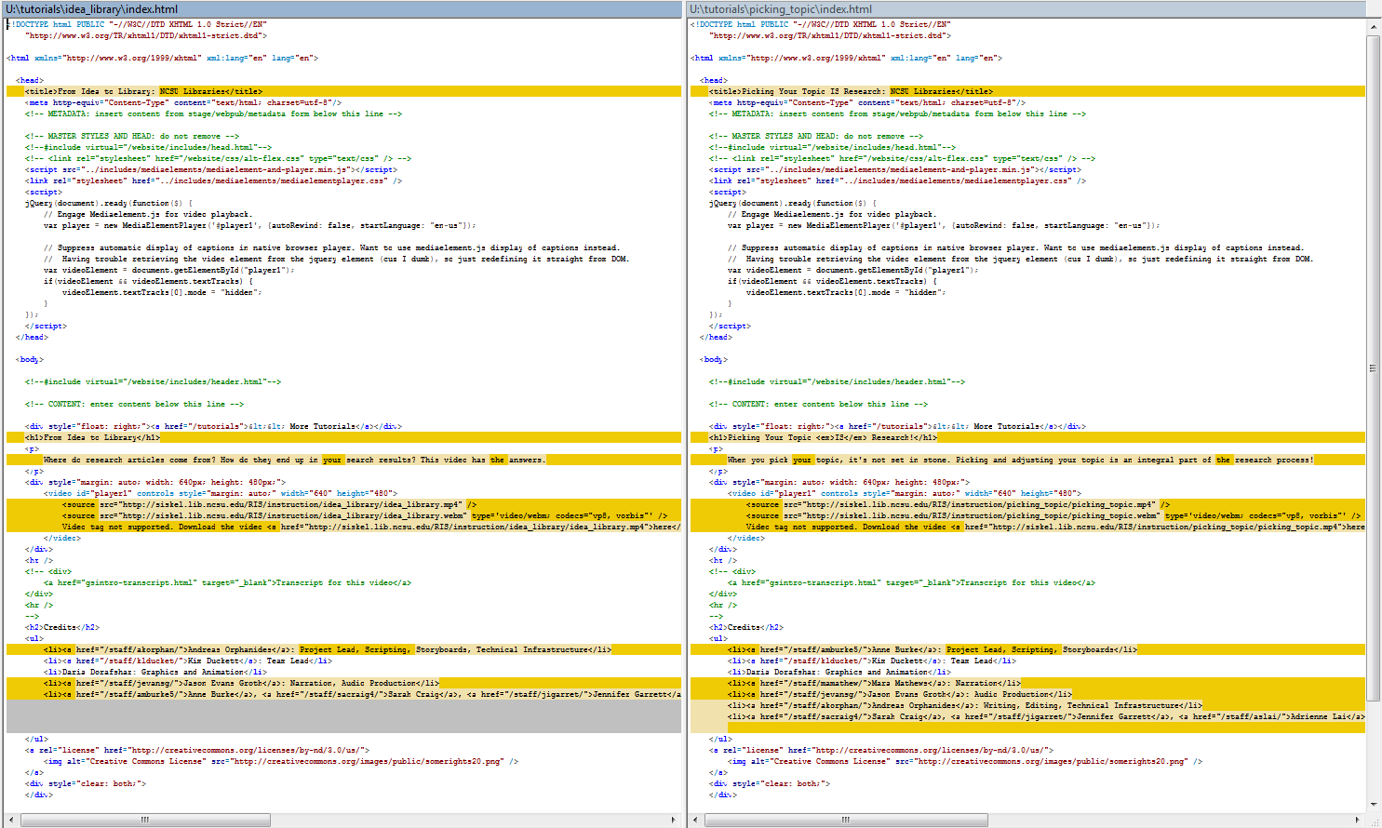
The Problem (part 2): Repetition
Titles
File names
Credits

Slide 6
The Problem (part 3): Diaspora
Video
captions
Video
config files
Video
source files
Video
thumbnails
Directories
with index files
Flash video
player

Slide 7
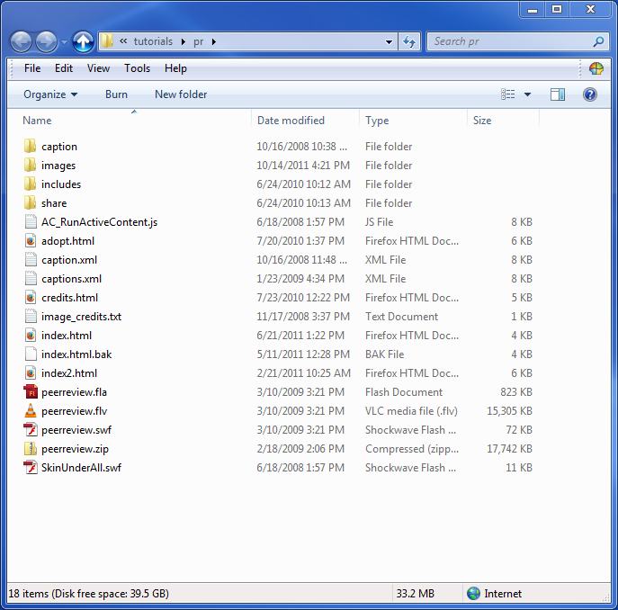
The Problem (part 4): Cruft
Video directory on staging server
Files in use in current practice:
… and that’s it.

Slide 8
The Solution
ONE script for video playback. (Well, two.)
Replace self with small script
Minimize clutter in web space!
Videos/metadata stored remotely
Keep content layer and display logic separate
Centralize mgmt of video and metadata
Videos and metadata stored together
Logical units are logical
Self-inventorying
It’s so simple!

Slide 9
SO SIMPLE
THAT I FEEL A
LITTLE GUILTY.

Slide 10
The Solution: Basic premise
Web server receives request:
http://server/MyVideo
Main script checks video server for /MyVideo directory.
Display script draws page, embeds video.

Slide 11
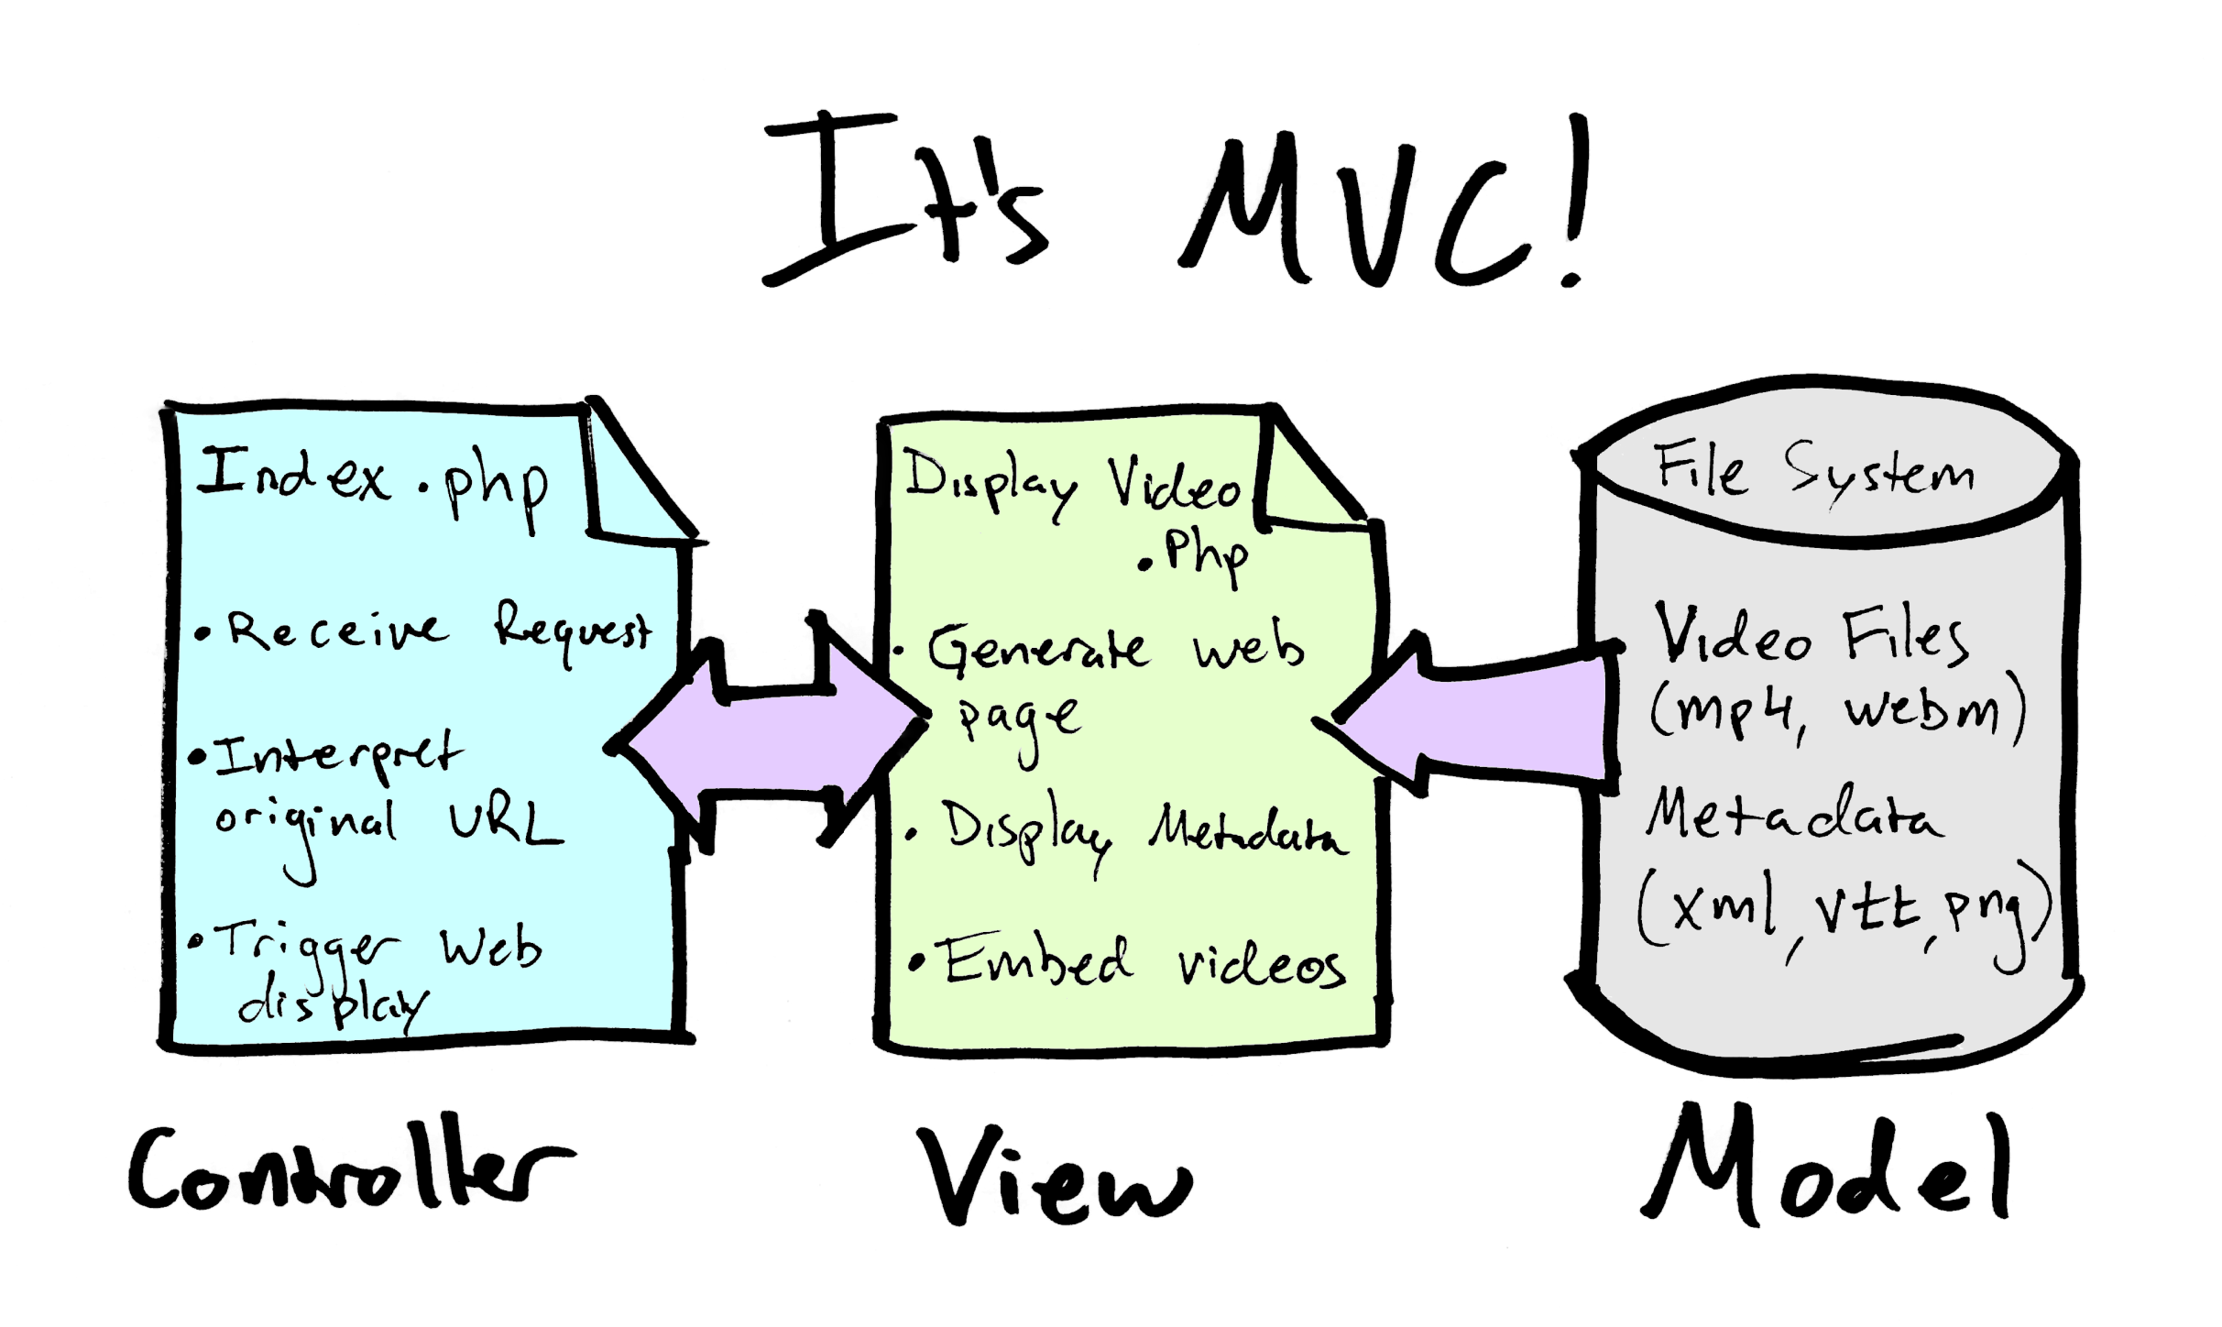

Slide 12
The Details

Slide 13
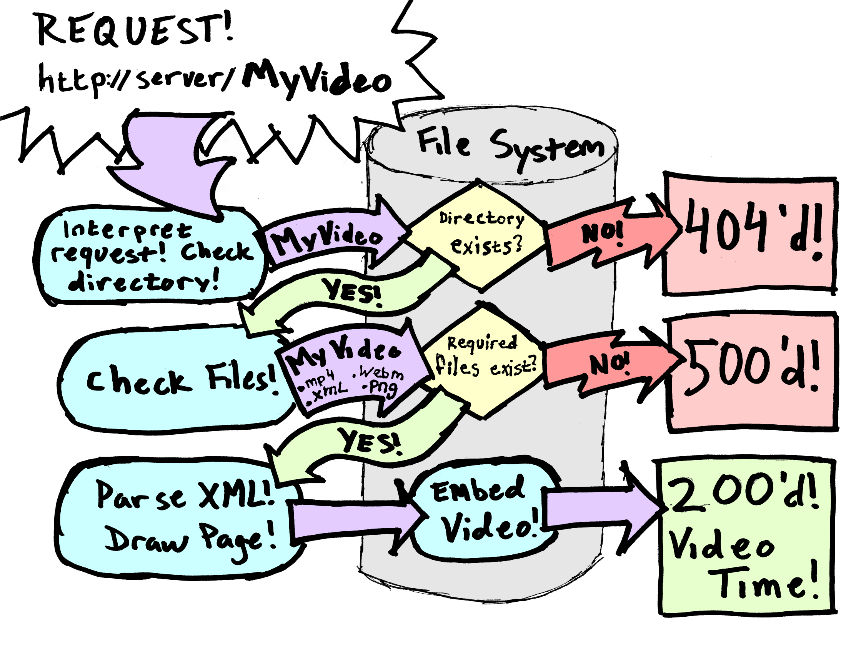

Slide 14
The Details: URL rewriting
Get request path from URL
Apache mod_rewrite:
# Prefer local files if they exist.
RewriteCond %{REQUEST_FILENAME} !-d
RewriteCond %{REQUEST_FILENAME} !-f
# Send full request path to script for parsing.
RewriteRule ^(.*)$ index.php?url=$1 [QSA, L]
For all URLs…
Call index.php,
capture original path…
Append any existing
query params…
… and stop rewriting.

Slide 15
The Details: Video directory
Vidserver/MyVideo/
Vidserver/MyOtherVideo/
Vidserver/TheBestVideo/
Assertion:
Directory exists → Video exists

Slide 16
The Details: Video directory
Vidserver/MyVideo/
MyVideo.mp4 (video file)
MyVideo.webm (video file)
MyVideo.xml (metadata)
MyVideo.vtt (captions)
MyVideo.png (poster)
* Required by script (status:500 if not present)

Slide 17
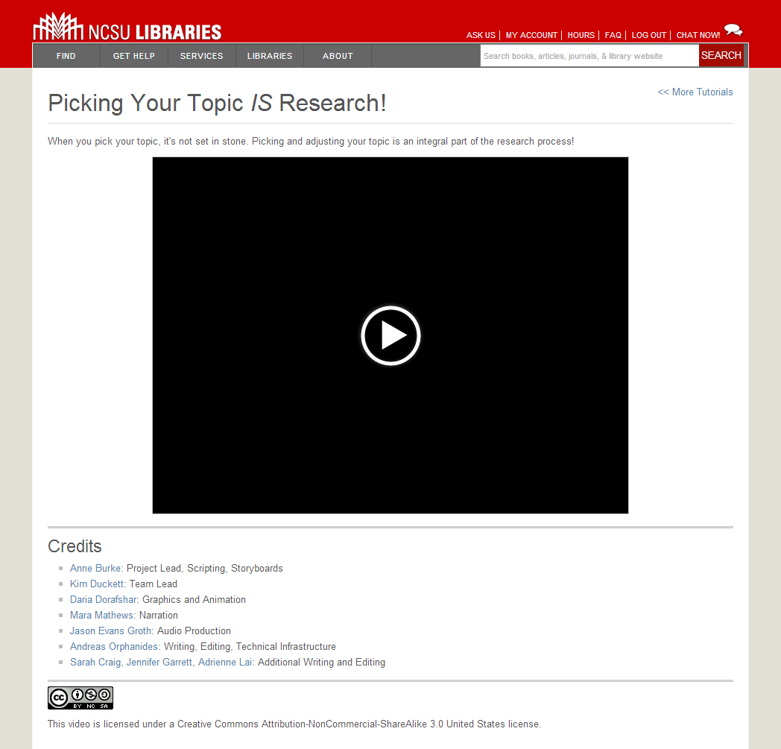
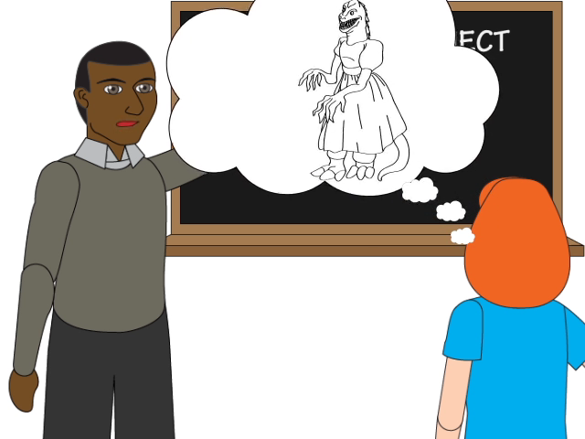
The Details: XML
Title (CDATA)
Blurb (CDATA)
Credits (structured)
License (structured)

Slide 18
The Details: XML
Why XML?
I’m writing it by hand (for now).
SimpleXML works real nice.
JSON is hard to read.
I’m lazy.
Please, Dre, show me the structure!
No. Ask me later.
… but it’s pretty ad hoc.

Slide 19
The Details: XML failure case
If XML file absent or invalid, define Title only:
MyVideo.mp4 → “My Video”
my_video.mp4 → “My Video”
Myvideo.mp4 → “Myvideo”

Slide 20
Conclusions

Slide 21
What’s nice
Simple!
Centralized, drop-in content management
Self-inventorying
Keeps web space clean
Works anywhere you can run a script
Graceful failure

Slide 22
Web directory: Before

Slide 23
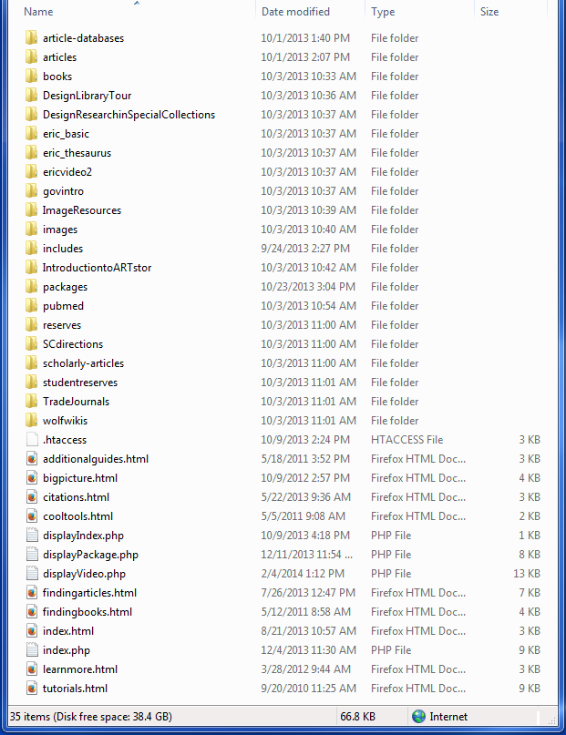
Web directory: After
And I’m not done cleaning yet.

Slide 24
Limitations
Discovery challenges – indexing
Solution: Gallery page
Metadata limitations – categories, etc.
Solution: ???
Content creators not isolated from system
Web forms, etc?
Compatibility with CM policy / practice?
Technical integration should be straightforward

Slide 25
Code-n-Stuff
...is on Dropbox.
Easy-to-remember URL:
https://www.dropbox.com/sh/ogo7su7shn0zegt/Ttv_5o_QZg
The scripts
XML examples
This slideshow

Slide 26

Questions?
KTHXBAI

